Slide 1
DATABASE MANAGEMENT SYSTEM
CS23332
EXERCISE 3
INCLUDING CONSTRAINTS
JOTHIKA K
241801110

Slide 2
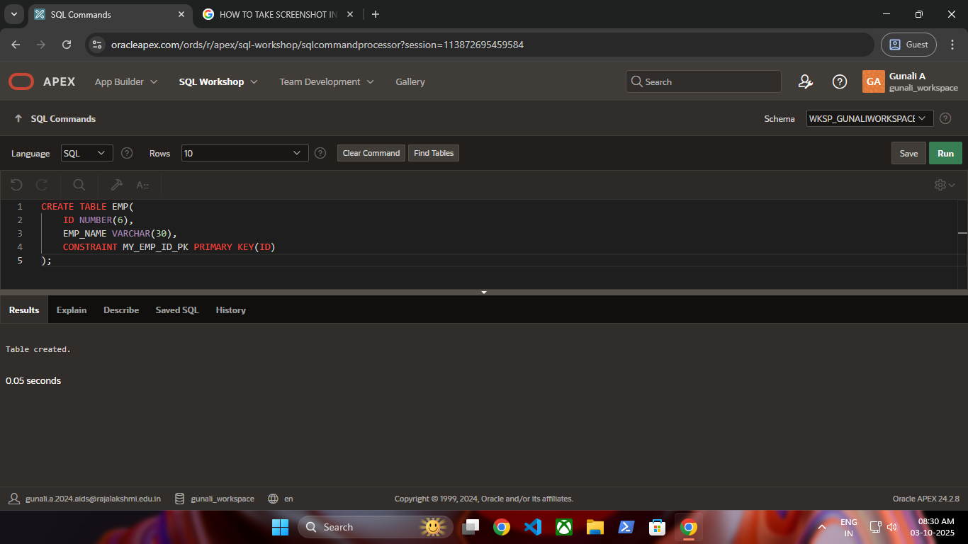
1. Add a table-level PRIMARY KEY constraint to the EMP table on the ID column.The constraint should be named at creation. Name the constraint my_emp_id_pk.

Slide 3
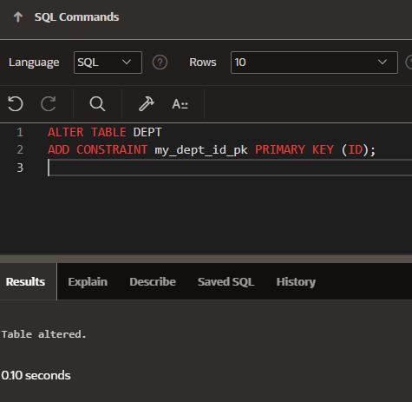
2. Create a PRIMARY KEY constraint to the DEPT table using the ID column. The constraint should be named at creation. Name the constraint my_dept_id_pk.

Slide 4
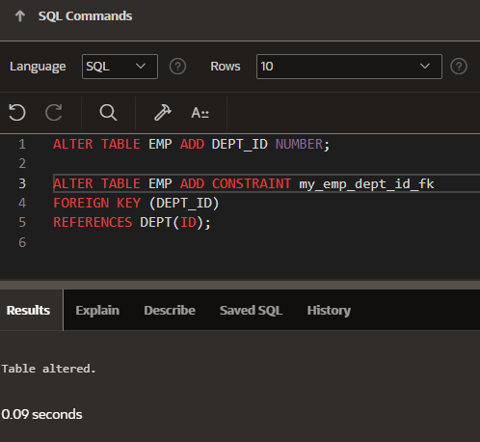
3. Add a column DEPT_ID to the EMP table. Add a foreign key reference on the EMP table that ensures that the employee is not assigned to nonexistent department. Name the constraint
my_emp_dept_id_fk.

Slide 5
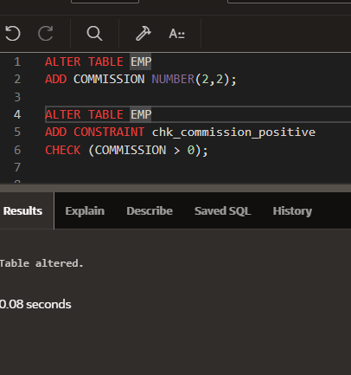
4. Modify the EMP table. Add a COMMISSION column of NUMBER data , precision 2,scale 2. Add a constraint to the commission column that ensures that a commission value is greater
than zero.

